Slide 1
Disputes:
How to keep costs and complexity under control
Faye Moore & Catherine McBride

Slide 2
Overview
Litigation strategy
Ending disputes sooner
Managing costs
Stakeholder engagement

Slide 3
Litigation strategy: early case assessment
Fight?
Delay?
Reframe?
Settle?

Slide 4
Case Study – Breach of Contract
You are legal counsel at TechNova, a software developer in workflow automation platforms.
TechNova entered an agreement with Harper Logistics to develop a workflow automation platform for Harper which would integrate with its existing system and to provide ongoing service support.
Harper sent you a notice of material breach alleging: the platform was incompatible with its existing system, milestones missed, frequent outages and lack of expertise.
You rejected the allegations: Harper did not follow the contractual change-control process, its existing system turned out to be incompatible, it failed to provide access to IT and the TechNova system did meet the requirements of the contract.
Harper has now terminated the agreement and claims:
£4.5m in operational disruption, £2m in additional contractor costs, £3.5m for replacement software.
TechNova’s position is that:
Losses are too remote and arise from Harper’s own system failures
Liability is contractually capped at 100% of annual fees (£600k)
The termination was wrongful and TechNova is owed unpaid and future fees and damages for reputational harm

Slide 5
Litigation strategy: fight?
Very high value dispute
Strong merits
Reputational issues
Precedent setting

Slide 6
Litigation strategy: settle?
Strategic consideration of best time to settle
  Highest point of your case
  For lowest cost

Slide 7
Litigation strategy

Slide 8
Litigation strategy

Slide 9
Litigation strategy

Slide 10
Ending disputes sooner
Dispute resolvers, not litigators
Procedural tactics
Alternative Dispute Resolution
Settlement
  Cost / benefit analysis
  Identifying blockers to settlement

Slide 11
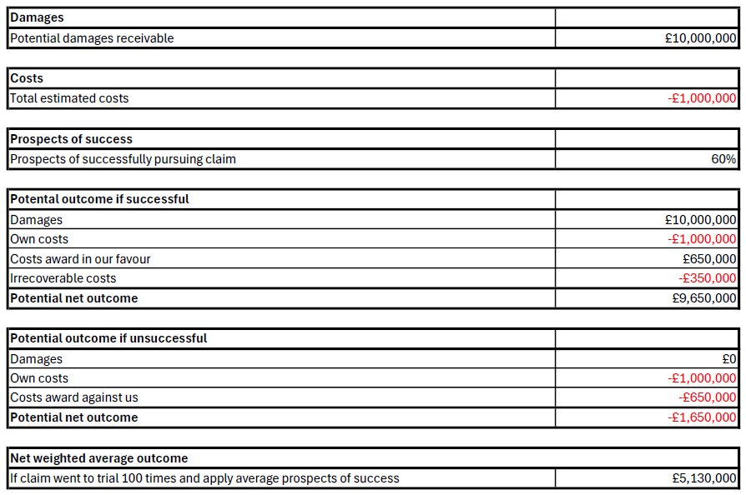
Ending disputes sooner: cost / benefit analysis
Harper v Technova
Cost / benefit analysis
Breach of contract claim - £10m
Acting for Claimant

Slide 12
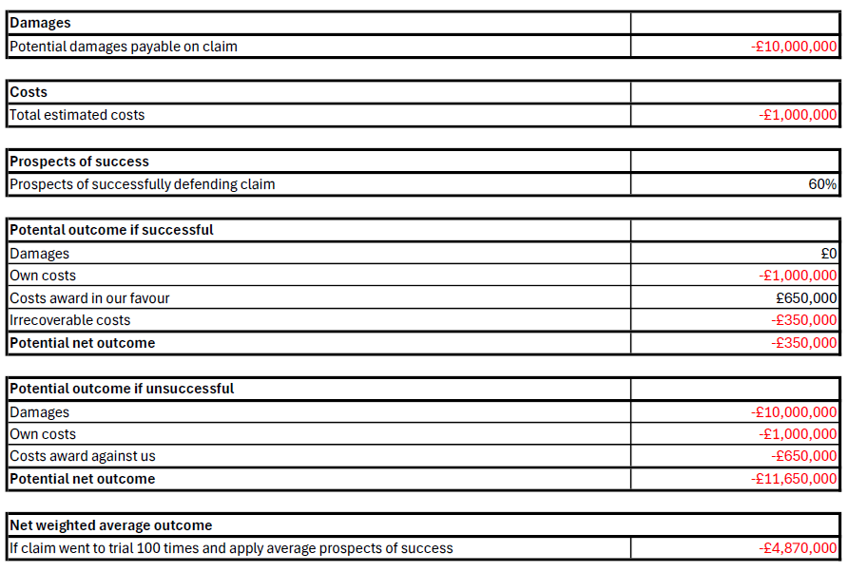
Ending disputes sooner: cost / benefit analysis
Harper v Technova
Cost / benefit analysis
Breach of contract claim - £10m
Acting for Defendant

Slide 13
Managing litigation costs: are high costs inevitable?
When are high costs unavoidable
    Legal and factual complexity
    Large volumes of material
    Urgency
    Cross-border disputes
  When are high costs avoidable
    Lack of early assessment
    Poor decisions
    Adopting a risk based/proportionate approach

Slide 14
Managing litigation costs: most expensive stages of litigation?
Pre-action
Statements of case
Case management conference
Disclosure
Witness statements
Expert reports
Trial

Slide 15
Managing litigation costs: most expensive stages of litigation

Slide 16
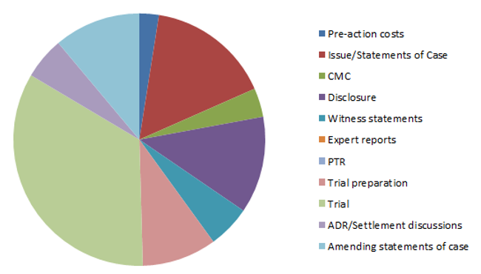
Managing litigation costs: most expensive stages of litigation

Slide 17
Managing litigation costs: avoiding and reducing costs
Realistic costs estimates
Clear agreements with external counsel
Fixed fees / cost capping
Detailed and regular reporting on costs:
  Estimated vs incurred costs reporting
  Weekly WIP reporting
Lower hourly rates
Tight case / project management
Use of AI

Slide 18
Managing costs of litigation:
Estimated vs incurred costs reporting

Slide 19
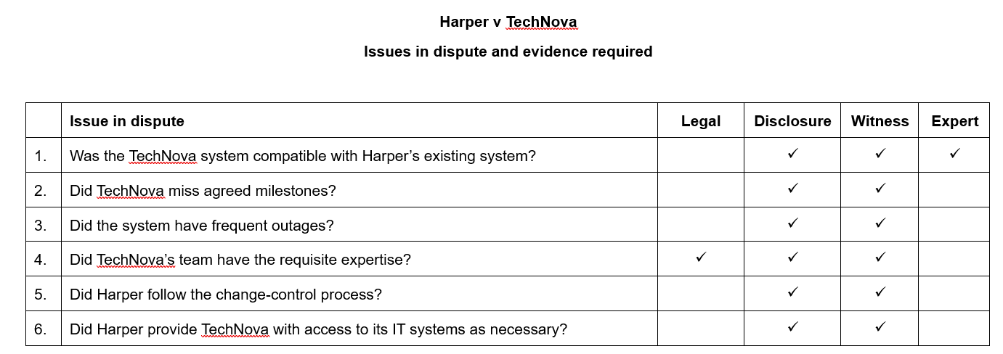
Managing costs of litigation
Case management: analysis of issues in dispute

Slide 20
Managing costs of litigation: avoiding future disputes
Root cause analysis
Contractual discipline
Company culture

Slide 21
Stakeholder engagement
Internal reporting playbook
One page reporting
Focus on strategic case management
Return on investment

Slide 22
Litigation strategy: return on investment
Consider ROI
  Contractual dispute – spent £60,000 to “gain” £1.2m
  Vicarious liability – spent £35,000 to “gain” £865,000
  Contractual dispute – spent £70,000 to “gain” £2m
  Contractual dispute – spent £60,000 to “gain” £1.3m
  Post-completion dispute – spent £1.75m to “gain” £10m

Slide 23

Link to slides and helpful documents

Slide 24
Thank you!

